Slide 1


Database Applications Laboratory with Mini Project [19IS5DLDBM]
Presentation on
“ Courier Management System ”
Presented By : LAB IN-CHARGE :
Pankaj Garg (1DS19IS066) Mrs. Bhavani K
Saquib Ameer Khan (1DS19IS089) Mrs. Rashmi S
Department of ISE, DSCE

Slide 2
Contents
1. Introduction
2. Requirements
3. ER Diagram
4. Schema Diagram
5. Queries used 6. Report analysis

Slide 3
Introduction:
Ecommerce is growing at a rapid pace, and it’s making parcel delivery a major concern for companies of all sizes. Large corporations and small businesses alike are wading into the waters of in-house delivery to reduce shipping costs and maintain control over their customer experience.
In-house courier delivery can be extremely beneficial if you do it well. You’d be hard-pressed to find a third-party courier service that cares more about your products and your customers than you do.
A courier management system, is business software that simplifies courier management and routing.

Slide 4
Requirements
Hardware Requirements:
PROCESSOR : Intel dual Core, i3/ i5/ i7 @1.0+ GHz
RAM : min 1 GB
HARD DISK : min 5 GB
Software Requirements:
OPERATING SYSTEM : Windows 8 / 9/ 10/ 11
FRONT END : PHP
SERVER SIDE SCRIPT : PHP
DATABASE : MySQL

Slide 5
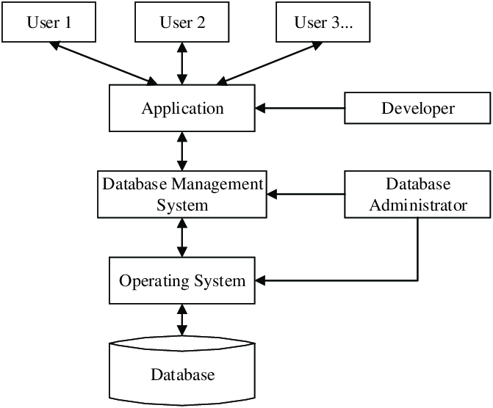

Slide 6
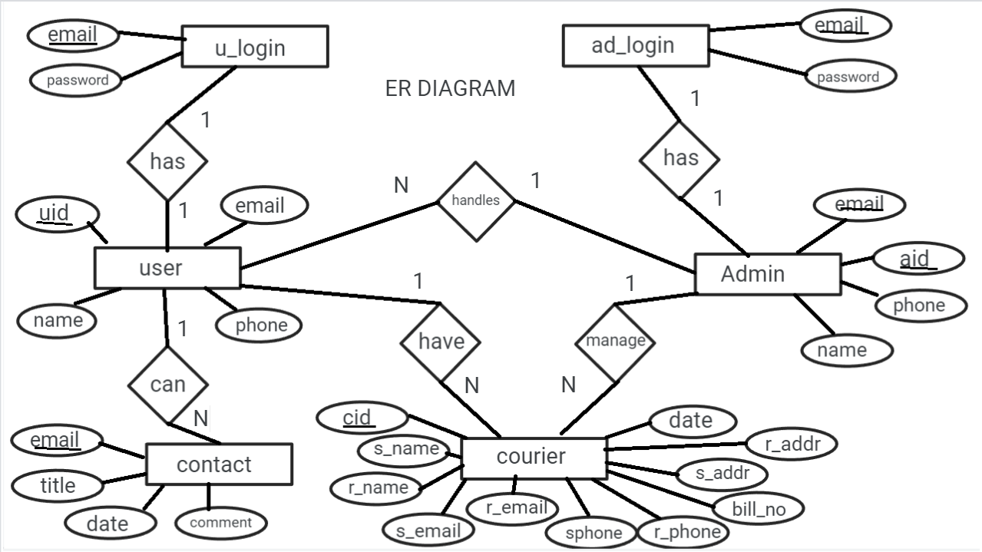
ER DIAGRAM

Slide 7
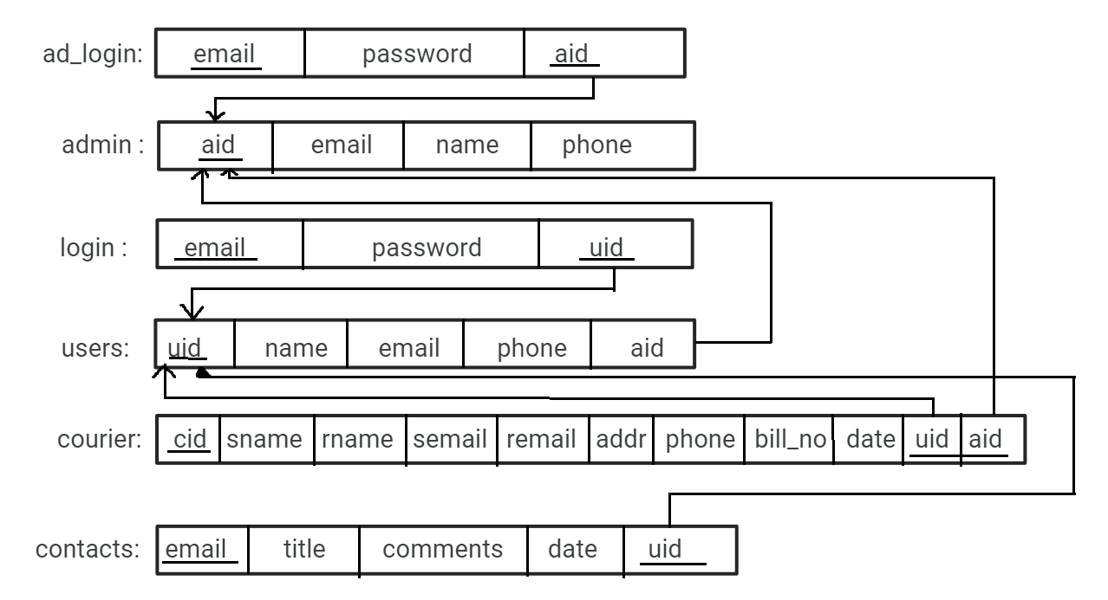
Schema Diagram

Slide 8
Queries used:
Insert - It is used to add new rows of data to a table in the database.
Update - It is used to update existing rows of data in the database.
Delete - The DELETE statement is used to delete existing records in a table.
Triggers- automatically runs when an event occurs in the database server.
Stored procedure- A stored procedure is a prepared SQL code that you can save, so the code can be reused over and over again.

Slide 9
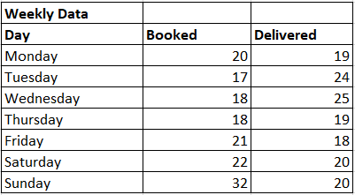
Report Analysis

Slide 10
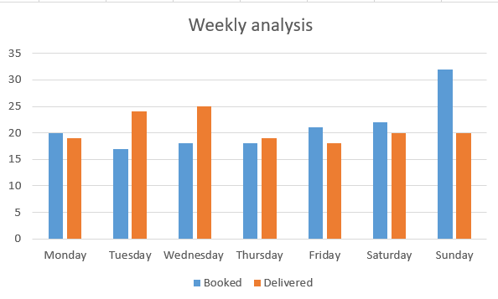

Slide 11


